Slide 1

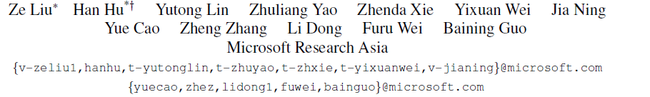

Swin Transformer V2: Scaling Up Capacity and Resolution
Presented by : H.N Srikanth (SM21MTECH12012)
Instructor : Dr. C Krishna Mohan
TA : Sai Harsha
Notes:
Swin Transformer V1 October 2021 ICCV
Swin Transformer V2 April 2022 CVPR
This implementation has been challenging because this paper was produced by Microsoft researchers but end of the day helped me to learn a lot.

Slide 2
Recap
Basic architecture
Swin Transformer Block
Differences between version 1 and version 2
Performance metrics and Implementation results
Results of paper
Novelty
Conclusion

Slide 3
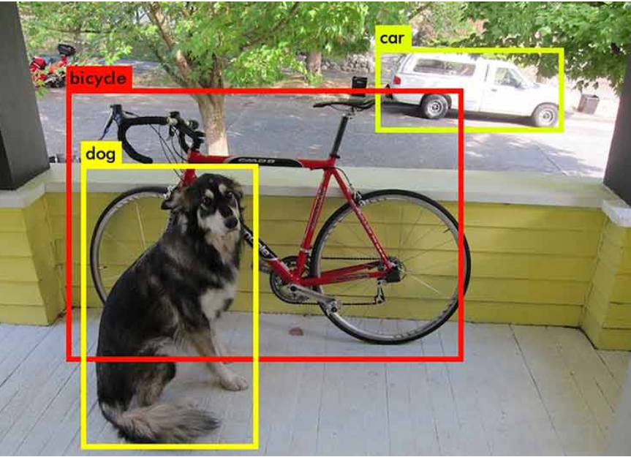
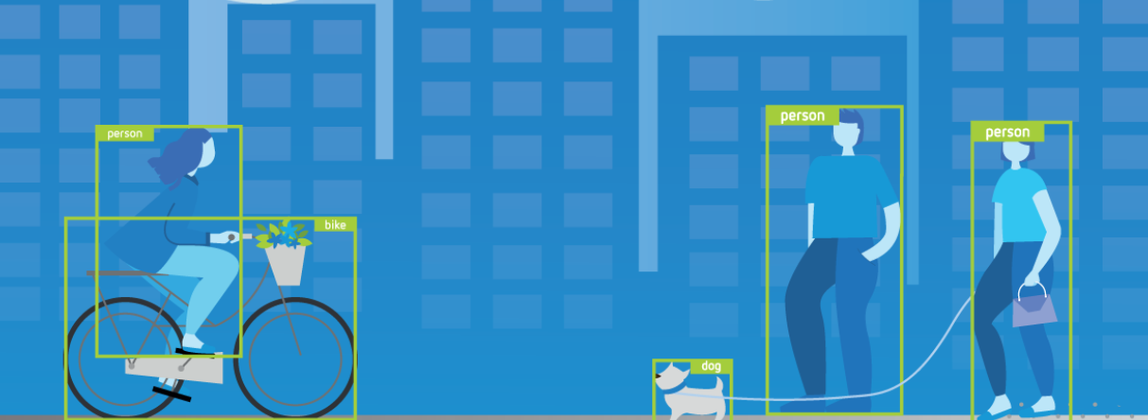
RECAP
Problem statement
Object Detection
Locate an object in the image.
Create bounding boxes around the target images.
Notes:
Object detection takes place in two steps localization and creating bounding box around that.

Slide 4
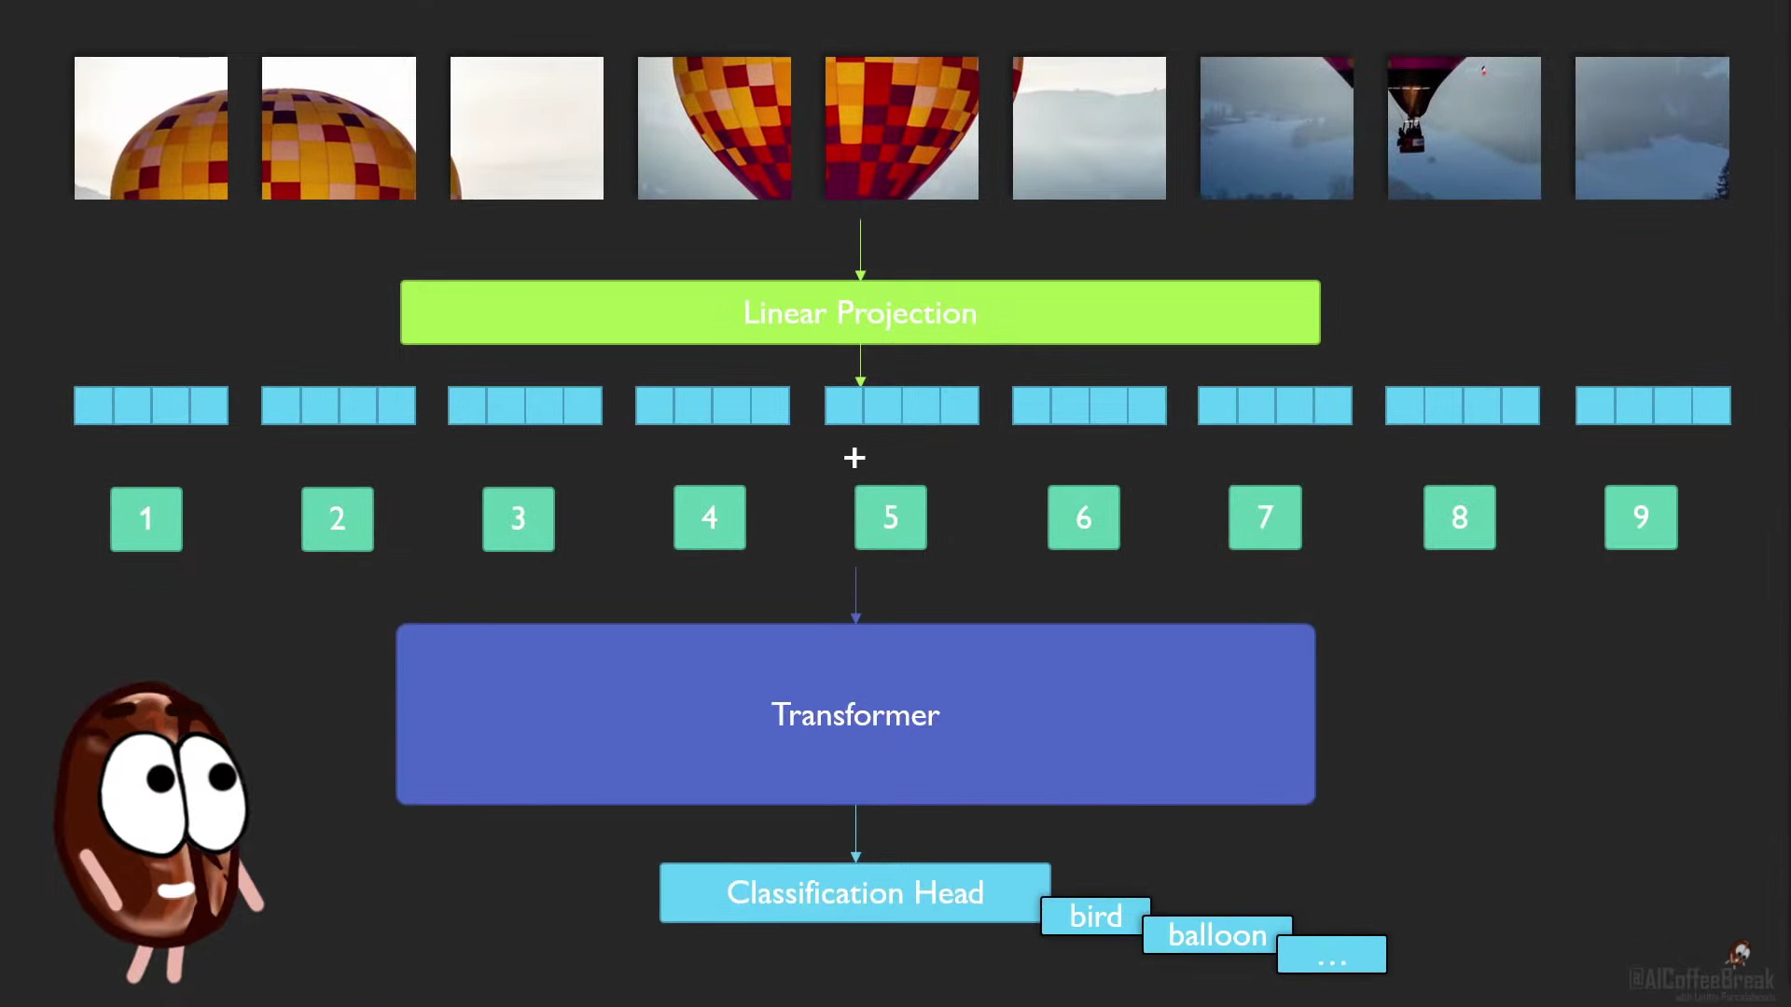
Vision transformer
Notes:
Main problem occurs with extraction of patches. 16*16 patches

Slide 5
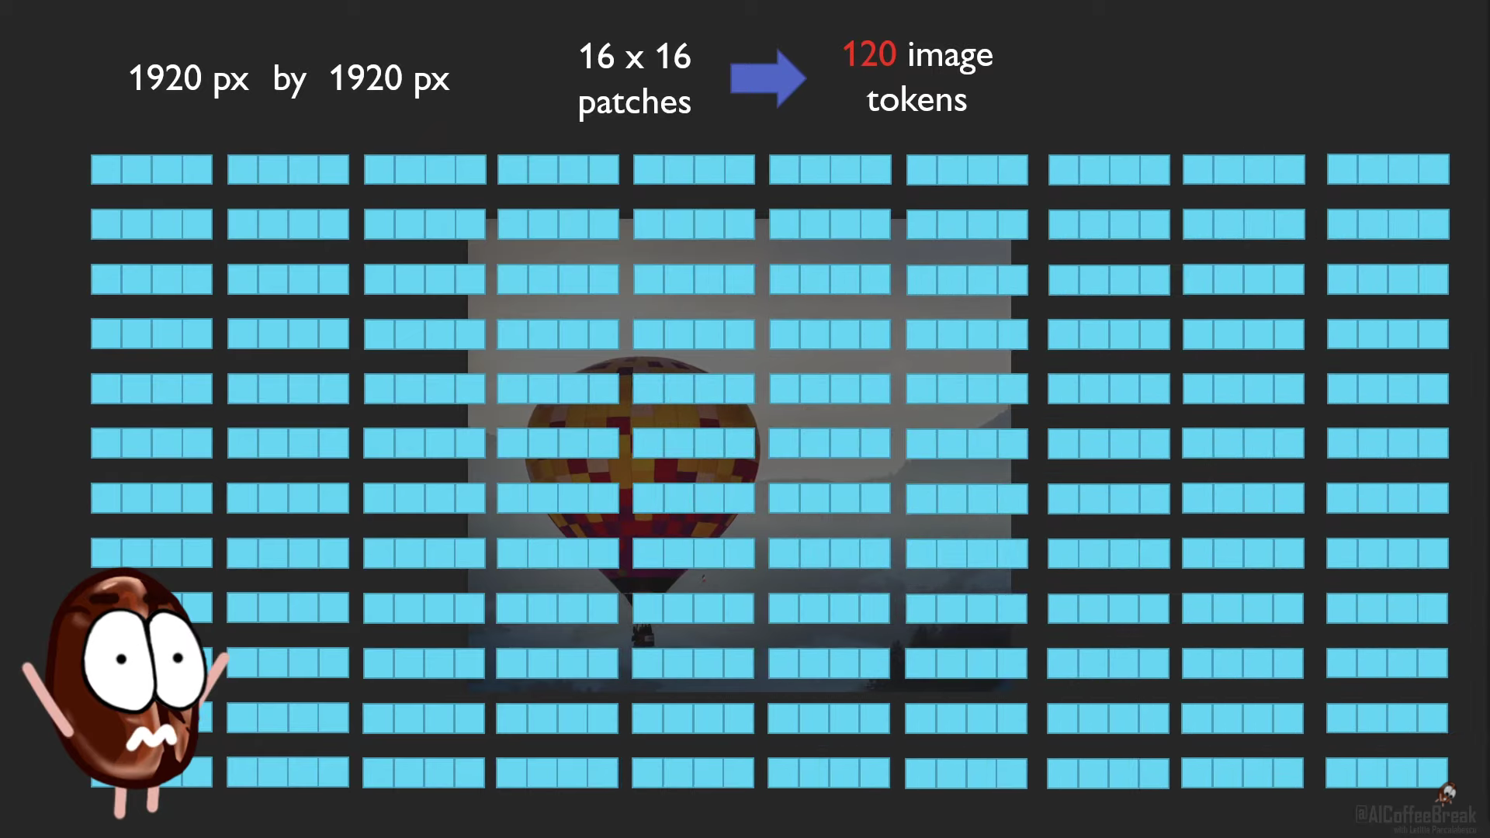
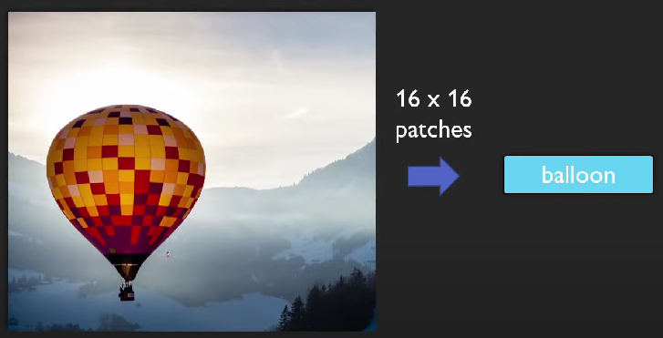
ViT can handle
Image classification

Slide 6
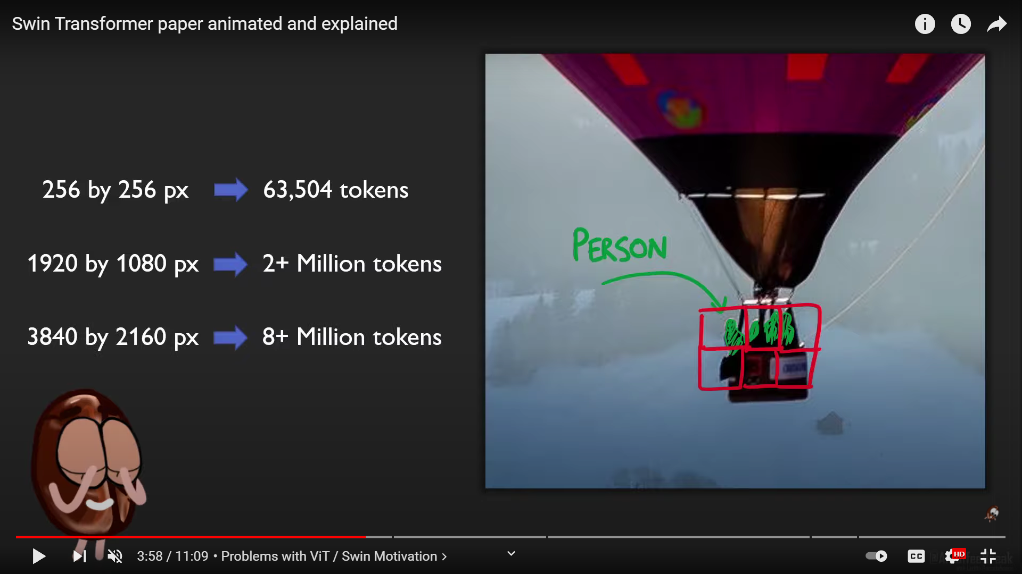
ViT
You can’t deal with us
Object detection, Instance segmentation

Slide 7
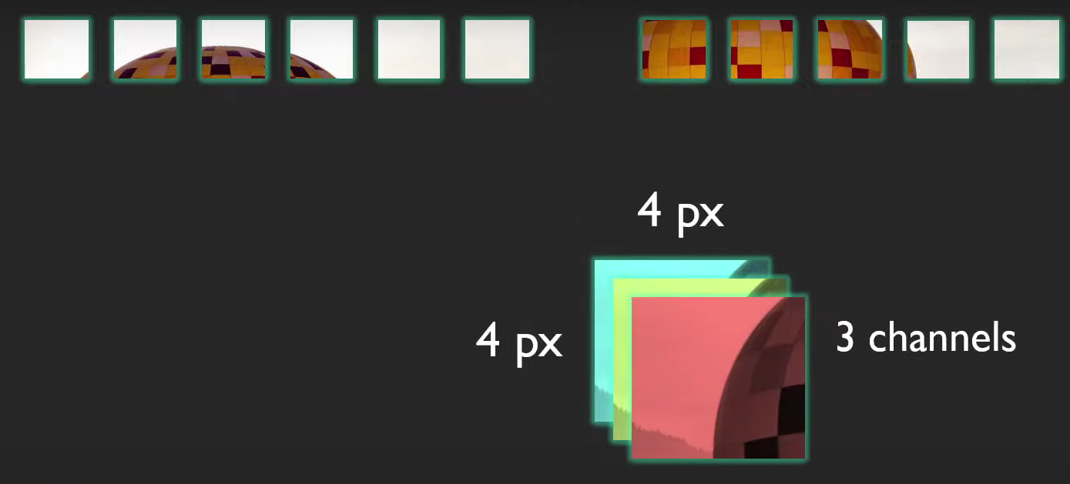
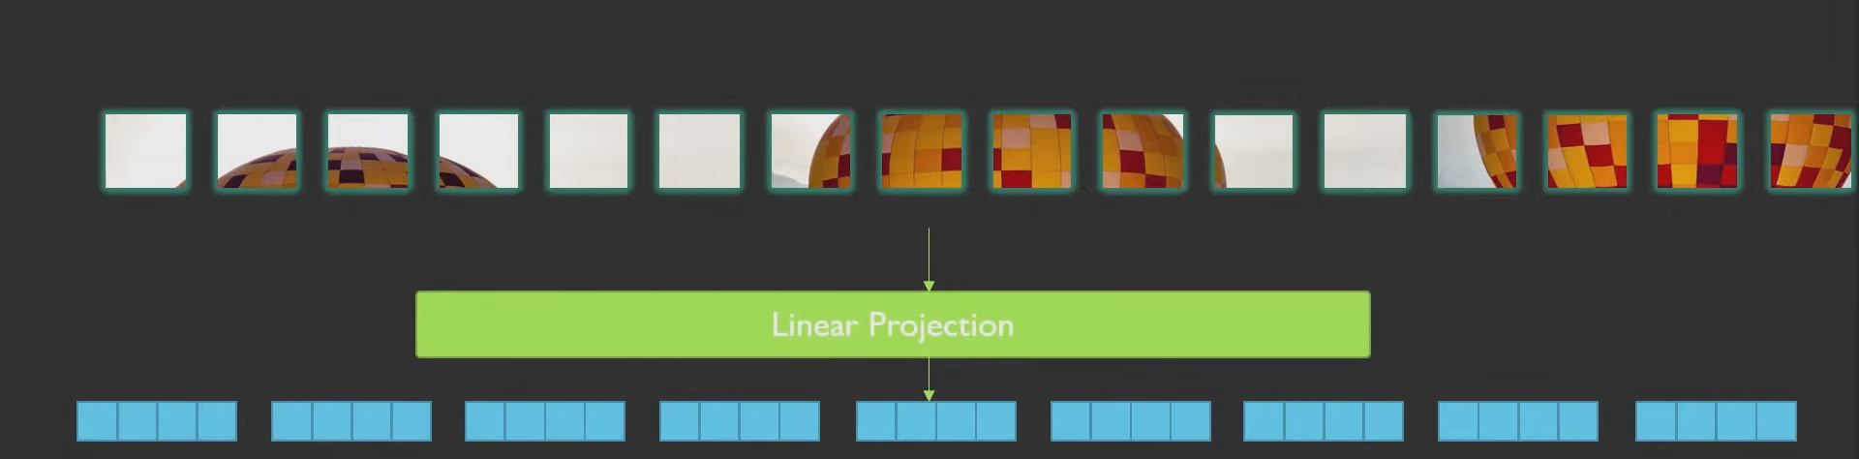
Swin Transformer
Challenges in adapting Transformers from NLP to vision are addressed with hierarchical Transformer i.e Swin Transformer.
Notes:
C Linear transformed vector size is 96 in swin tiny 192 in swin large

Slide 8
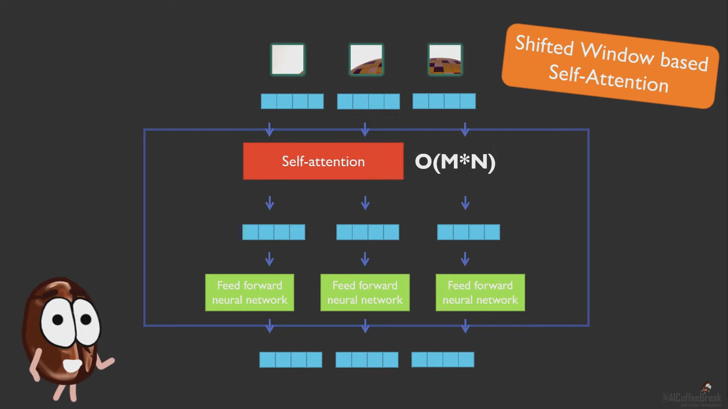
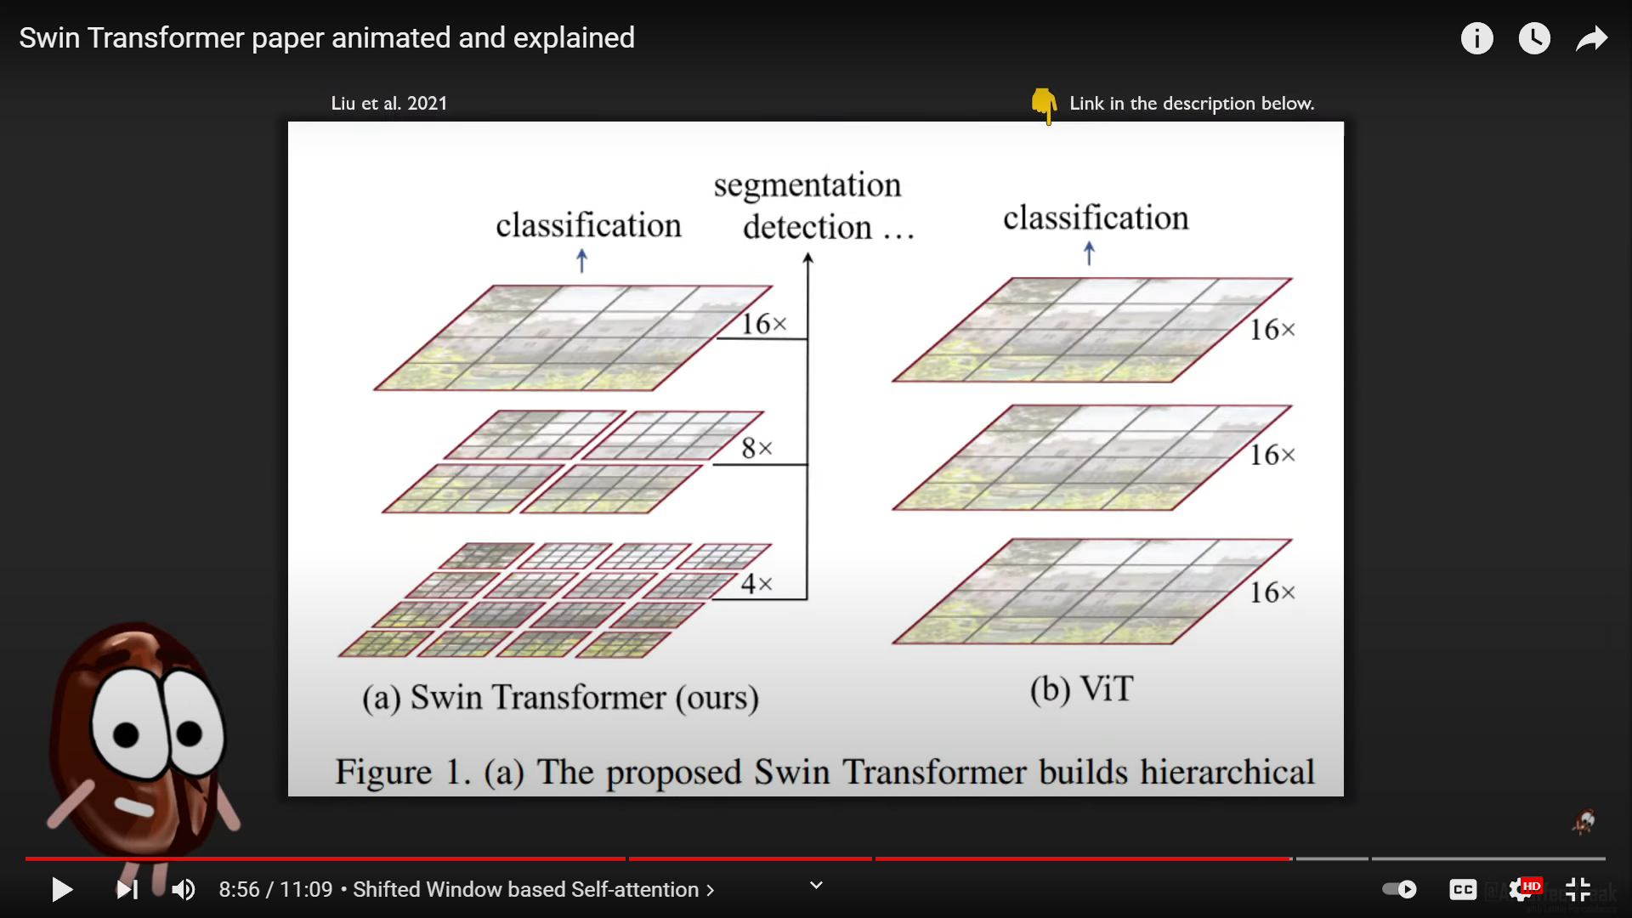
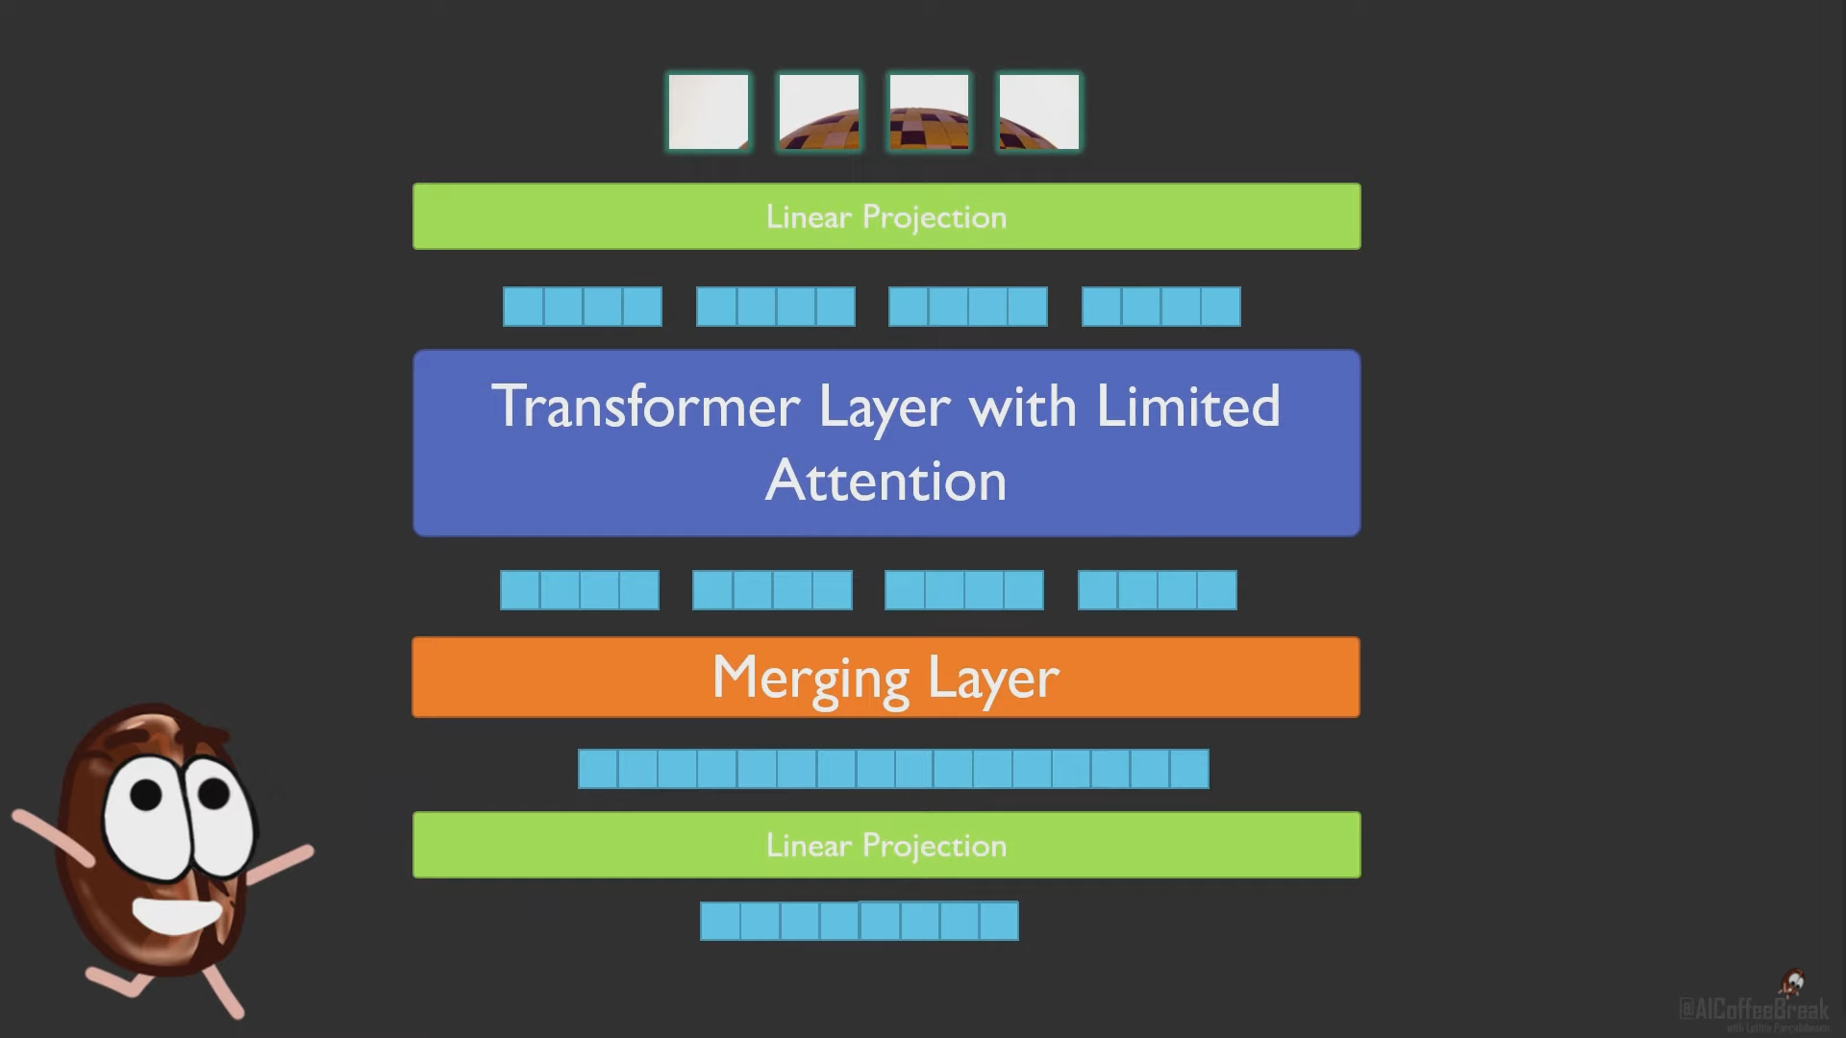

Slide 9
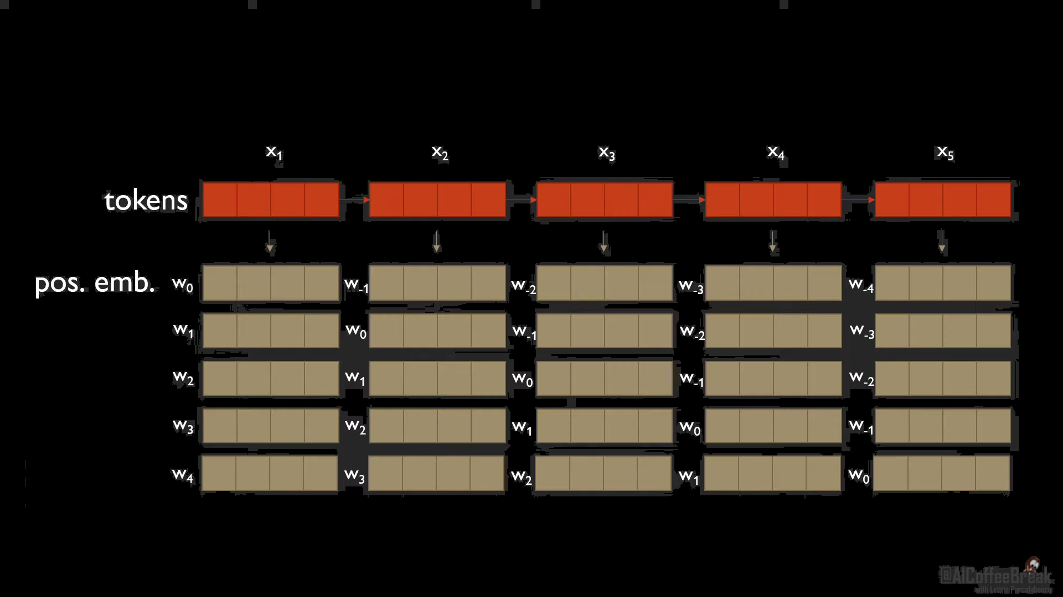
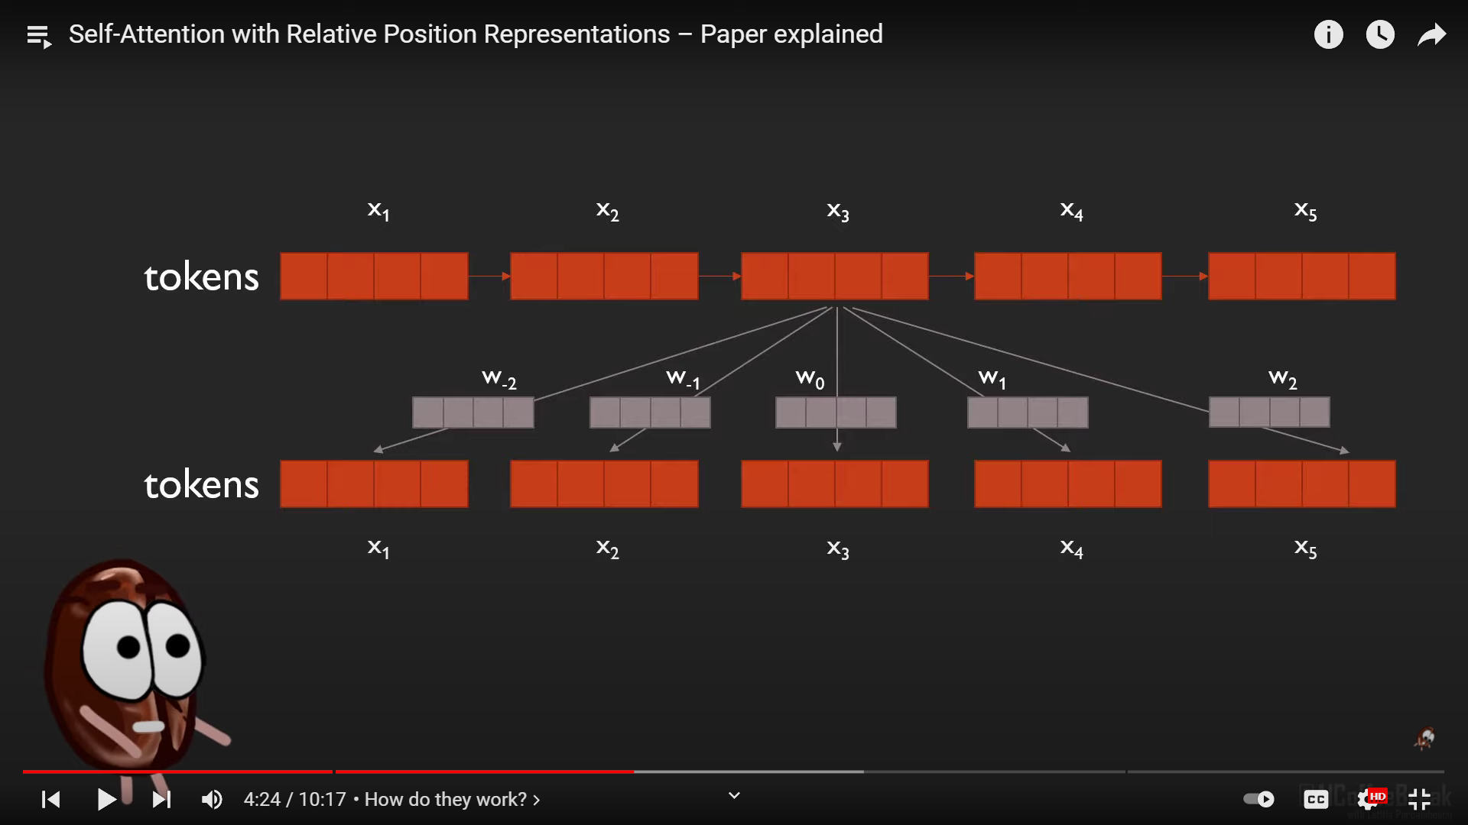
Relative positional bias introduced in Swin Transformer

Slide 10
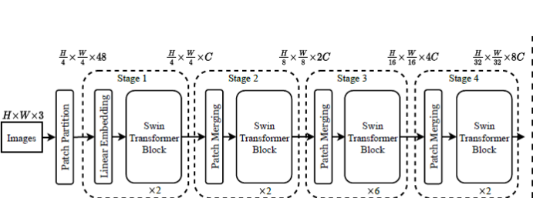
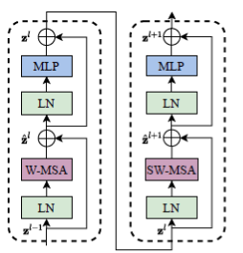
Architecture
Two Swin Transformer blocks

Slide 11
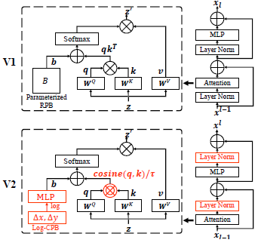
In V2
Post norm replaced Prenorm
Scaled cosine attention replaced Dot product attention
Log CPB replaced Parameterized approach

Slide 12
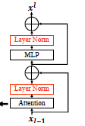
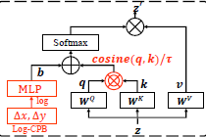
Layer norm is implemented after MLP block which results in Post Normalization.
A scaled cosine attention approach is implemented to get rid of dominated pixel pairs.
Sim(q_{i} , k_{j}) = cos (q_{i},k_{j})/ꞇ + B_{ij}
B_{ij} is relative position bias between i and j Ꞇ is learnable scalar.
These are the reasons behind scaling up the capacity.

Slide 13
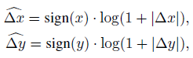
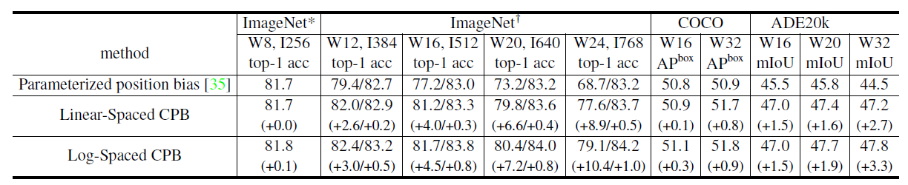
With Log spaced continuous positional bias, extrapolation ratio will decrease thereby transferring between windows will be feasible.
where Δx, Δy and are the linear-scaled and logspaced coordinates, respectively.
This is reason behind scaling up window resolution
For example extrapolation ratio to shift from 8*8 to 16*16 window size is 1.14x with parameterized approach . It will reduce to 0.33x in log spaced approach.

Slide 14

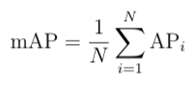
Performance metrics and Implementation results
Performance Metrics used is mAP mean Average Precision.
mAP0.5 mean intersection with threshold of 0.5, mAP0.5-0.95(0.05) average of accuracies
calculated over thresholds 0.5 to 0.95 in steps of 0.05
AP is average precision over all test data.

Slide 15
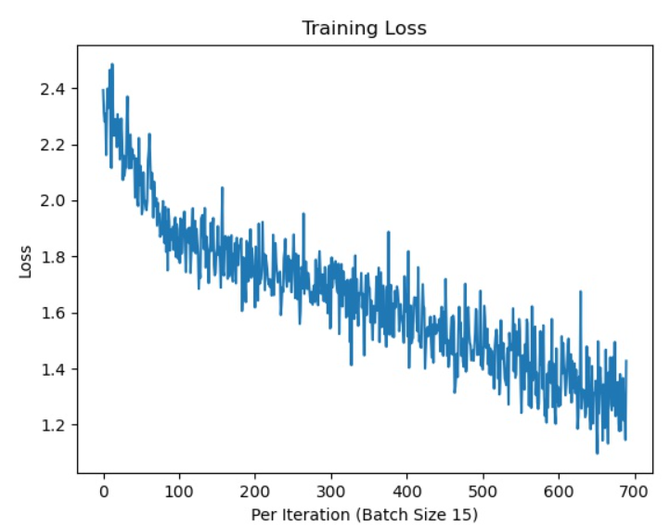
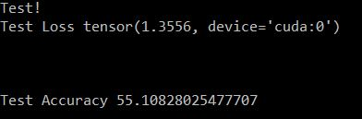
Swin V2 T with C=96, layer numbers = 2, 2, 6, 2
GPU used : Tesla V100 SXM3 32 GB with CUDA 11.6
Code base : MMCV
Done Training for 10 epochs on COCO dataset
Notes:
Implemented Swin V2 Tiny with C

Slide 16
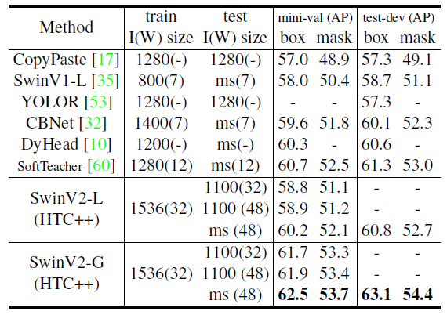
Results of paper
Actual results they ran for 100 epochs which requires multiple GPUs and take more time.

Slide 17
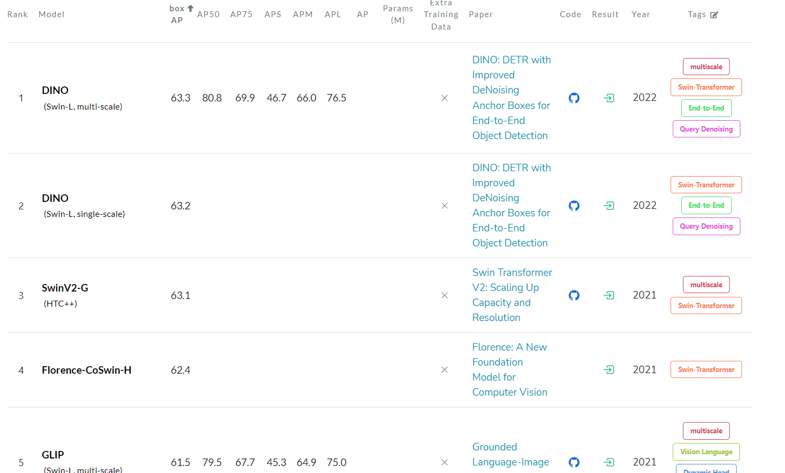
As on 2022 Top 9 accuracy models on COCO dataset have Swin backbone

Slide 18
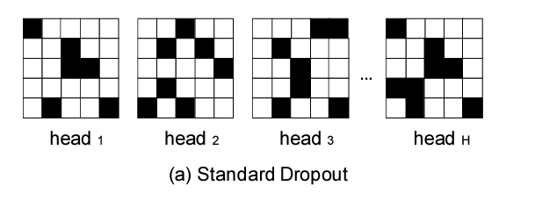
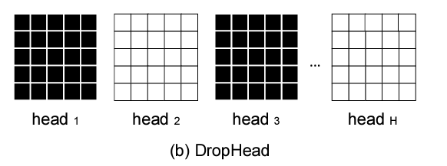
Novelty
Scheduled Drop Head
Drops entire head in Multi head attention model

Slide 19
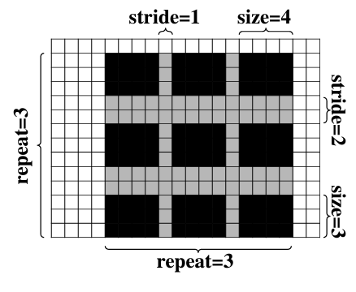
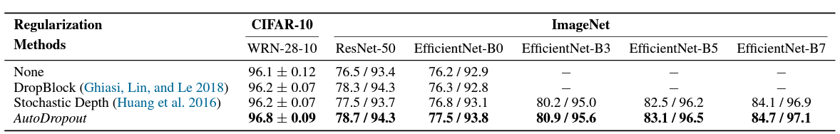
Auto dropout
In this image black cells are dropped out and gray cells are retained.
These patterns are learned over the training.

Slide 20
Conclusion:
CNNs served as the standard backbone throughout computer vision for many years.
Self attention based backbones came into play because of their success in NLP.
But the adaption of Transformers into vision is not easy because of large image size and big capacity of the models required.
Swin Transformer is one of the attempt to overcome these capacity and resolution issues with 3B+ parameters which gave notable results in vision community.
But interestingly Convnets came back with A ConvNet for the 2020s paper published earlier in this year by Facebook AI.
Currently I am Working with Vishnu sir(PhD) to implement Swin Transformer on POTHOLE detection problem for autonomous vehicles.

Slide 21
References
[1] Swin Transformer V2: Scaling Up Capacity and Resolution Ze Liu, Han Hu, Yutong Lin, Zhuliang Yao, Zhenda Xie, Yixuan Wei, Jia Ning, Yue Cao, Zheng Zhang, Li Dong, Furu Wei, Baining Guo
[2] Swin Transformer: Hierarchical Vision Transformer using Shifted Windows Ze Liu, Yutong Lin, Yue Cao, Han Hu, Yixuan Wei, Zheng Zhan, Stephen Lin, Baining Guo
[3] An Image is Worth 16x16 Words: Transformers for Image Recognition at Scale Alexey Dosovitskiy, Lucas Beyer, Alexander Kolesnikov, Dirk Weissenborn, Xiaohua Zhai, Thomas Unterthiner, Mostafa Dehghani, Matthias Minderer, Georg Heigold, Sylvain Gelly, Jako Uszkoreit, Neil Houlsby
[4] Attention Is All You Need Ashish Vaswani, Noam Shazeer, Niki Parmar, Jakob Uszkoreit, Llion Jones, Aidan N. Gomez, Lukasz Kaiser, Illia Polosukhin
[5] Scheduled DropHead: A Regularization Method for Transformer Models Wangchunshu Zhou, Tao Ge, Furu Wei, Ming Zhou, Ke Xu
[6] AutoDropout: Learning Dropout Patterns to Regularize Deep Networks Hieu Pham, Quoc V. Le

Slide 22
Any Questions….
THANK YOU for your attention

